Slide 1




Identification of DNA Exon-Intron Boundaries
Team Name- Huh?
Prachi Bindal- 220102071
Krish Mangal- 220102051
Kushagra Singh Sisodia- 22102052
Tanu Siwach- 220108059

Slide 2


Problem Statement
The challenge presented in this dataset involves identifying specific points on a DNA sequence known as splice junctions. These junctions are where unnecessary sections of DNA are removed during the protein creation process in more complex organisms. The task at hand is to accurately detect, based on a given DNA sequence, the transitions between exons (segments retained after splicing) and introns (segments spliced out). This task comprises two main objectives: identifying boundaries between exons and introns (referred to as EI sites), and identifying boundaries between introns and exons (referred to as IE sites).

Slide 3
Methodology
Input:
The input has 181 columns representing 60 nucleotides and a last column representing the class.
The class itself has 3 types :
1 represents: EI: Exon-Intron boundaries (donors)
2 represents: IE: Intron-Exon boundaries(recipients)
3 represents: Neither: Neither exon nor intron
Split data set:
We have split the data into 4:1 ratio or in other words, kept 80% as training data and 20% as testing data

Slide 4
Methodology
We then utilize Stacking implemented on two base models that are Random Forest and Gradient Boosting.
The stacking methodology will use Logistic Regression further to combine the predictions from both base models and fit them to the training data output.

Slide 5
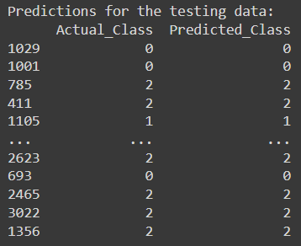
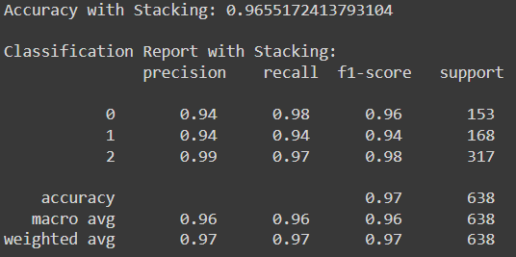
Output
After this predictions made on the testing data provide the classifications of the nucleotide chain.

Slide 6
Thank You

